Slide 1
Designing for Visual Perception
JOUR479D/779D
University of Maryland

Slide 2
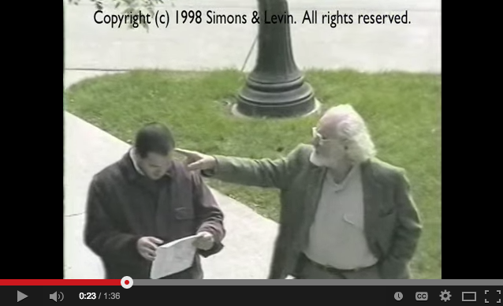
Attention
Notes:
Classic study from Simons and Levine showing that change blindness can occurr out in the world. It points out a key weakness in the human visual system which is that when you are very focused on one thing, you may miss something else entirely.
Attention allocation is key to visual thinking: While we’re sensitive to changes in the focus of our attention, we are suprisingly blind to changes when attention is not engaged.

Slide 3
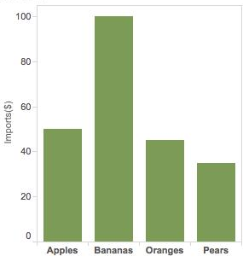
Visual Queries
“Visual thinking consists of a series of acts of attention, driving eye movements and tuning our pattern-finding circuits.”
-C. Ware
Notes:
These acts of attention are what ware called “visual queries”
Example: to figure out which kind of fruit imports is the largest we make a visual query to find the tallest bar, then find and read the label beneath

Slide 4
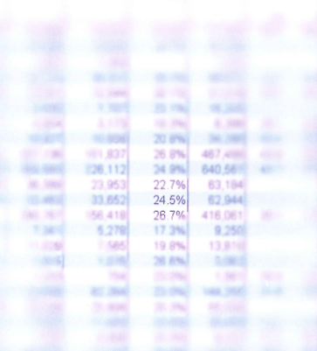
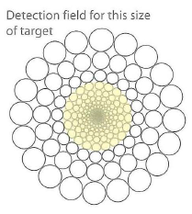
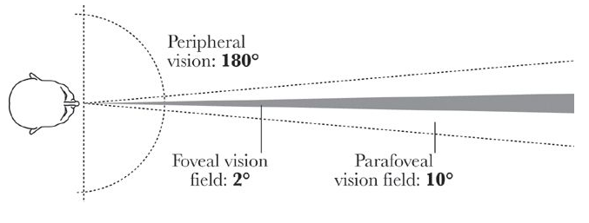
Foveal vs. Peripheral Vision
Hi-Res camera only at the center of your eye (fovea)
You can’t see color in periphery
But periphery is very sensitive to motion
Your eyes move a lot - saccades
Notes:
Vision varies across the visual field. We can only see things at high resolution at the center of our visual field.
Outside of the parafovea the retina only has rods, which means no color
Flashlight metaphor of searching in a dark room. Cells at the edge of field have lower resolution, so you have to move your eye to see the details there.
Talk about the design implications: don’t distract someone with motion in your vis unless you really need/want them to look at something. Blinking can get annoying.
Orienting response – as things emerge into visual field we notice them

Slide 5
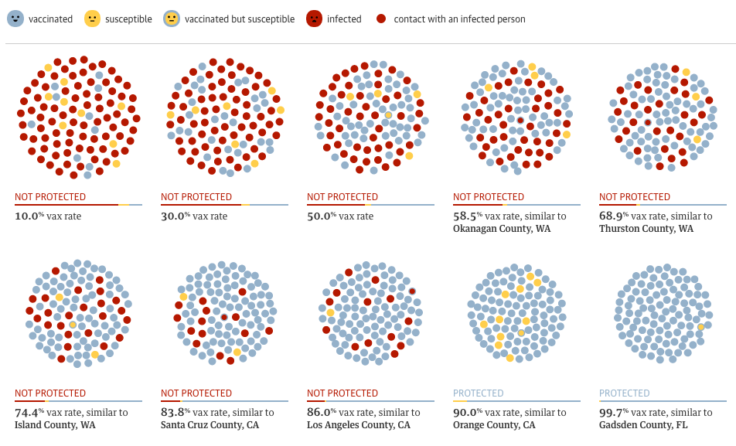
Motion
http://www.theguardian.com/society/ng-interactive/2015/feb/05/-sp-watch-how-measles-outbreak-spreads-when-kids-get-vaccinated

Slide 6
Visual Queries & Design
How well does a visualization design support likely visual queries of user?
What tasks does user need to accomplish? As a result what visual queries should a design support?
What visual queries are easily executed?
How to map data to colors, marks, space to efficiently service those queries?
Notes:
And I would argue that storytelling is also about directing attention and revealing information in patterns. Visual storytelling is a series of authored visual queries that you want someone to make. That the juxtaposition, or pattern of visual queries builds towards something greater.

Slide 7
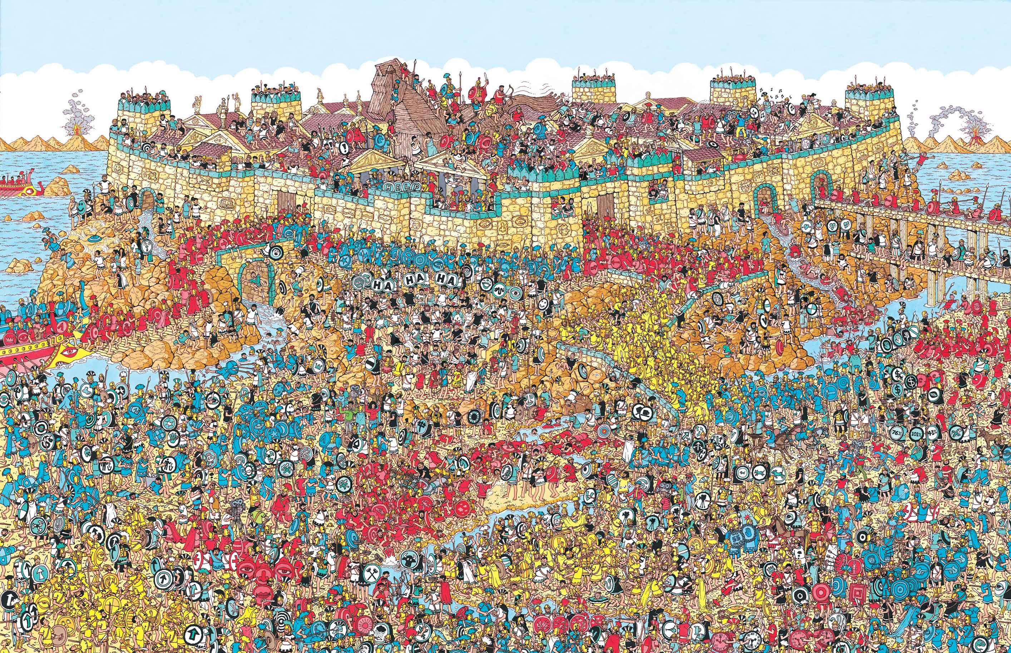
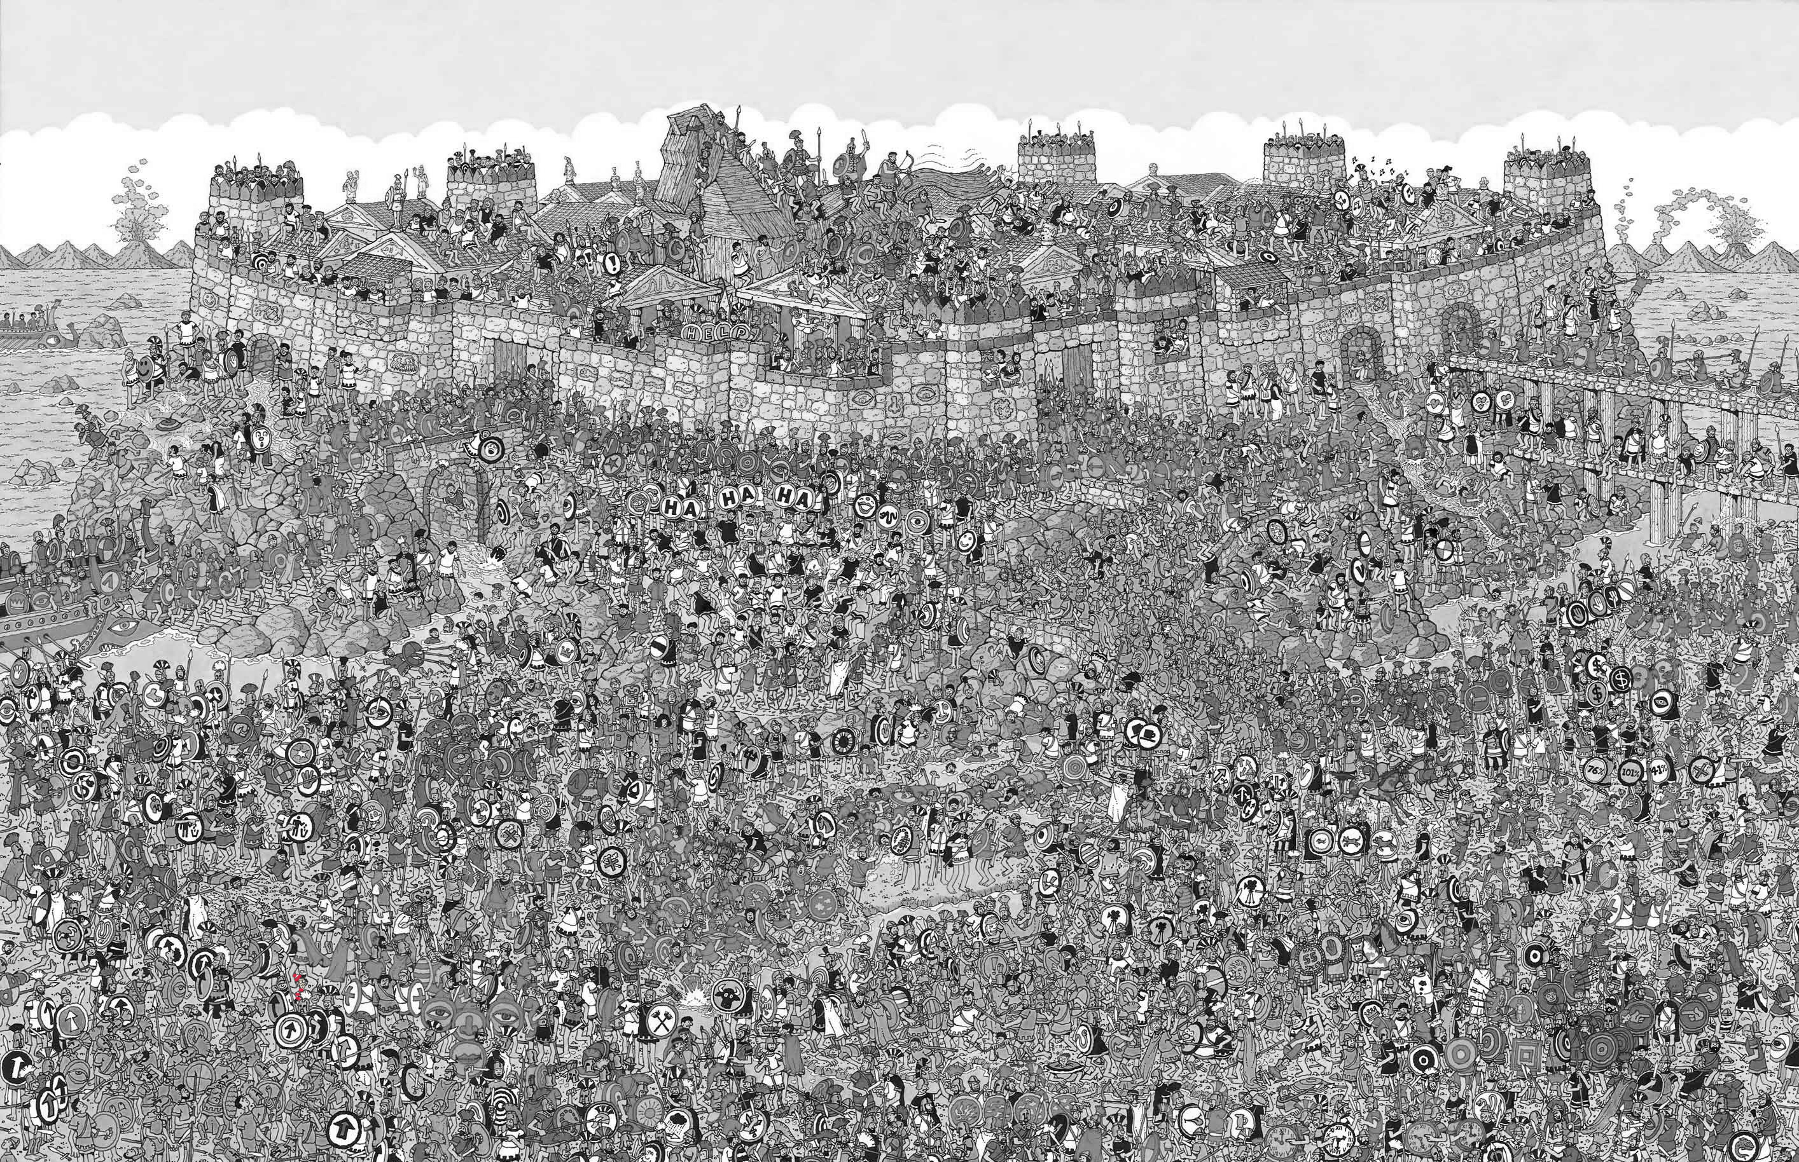
Waldo & Visual Distraction
Notes:
Idea that visual features can be distracting from a goal, this can also be pleasurable.
But if we re-encode so that the visual query is supported better it’s much more efficienct to find waldo

Slide 8
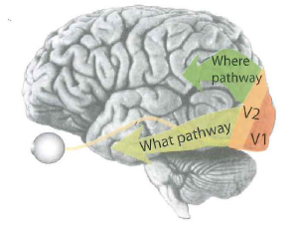
“Preattentive” Features
Automatic processes that occur before attention is tuned in
Pop out effect seen in a single eye fixation (< .10s)
Enables very quick visual search rather than slow serial searching

Slide 9
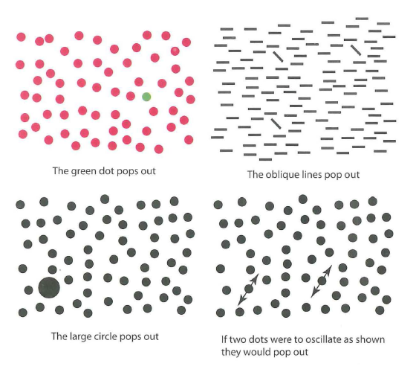
“Preattentive” Features
Distinctness
Is it different than its environment / context
Does it contrast
Features
Color, orientation, size, motion, depth

Slide 10
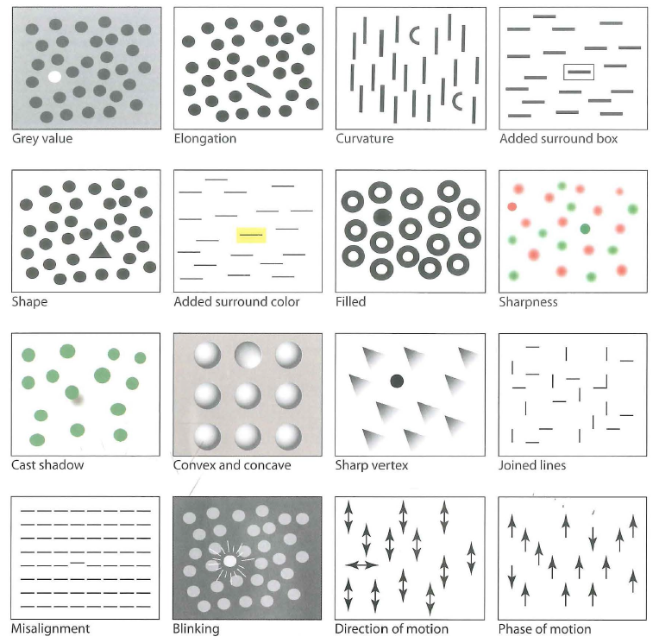
“Preattentive” features
http://www.csc.ncsu.edu/faculty/healey/PP/index.html
Notes:
Link has some more examples of animated distractors.

Slide 11
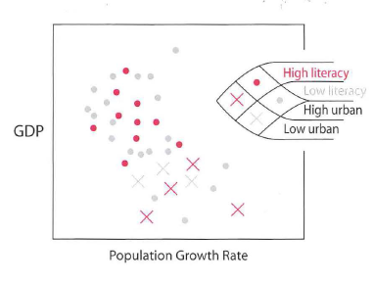
Design Lessons
Contrast to surroundings is important
Color, size, curvature, movement
Utilizing multiple channels
Notes:
Supporting quick visual queries across multiple variables in a scatter plot is supported by encoding one as color and the other as shape.

Slide 12
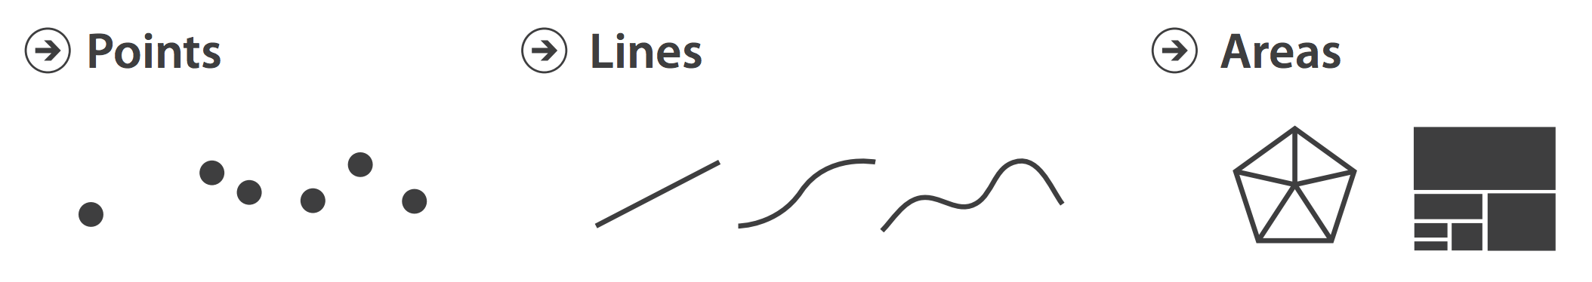
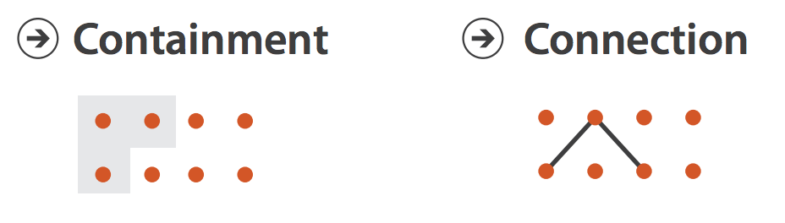
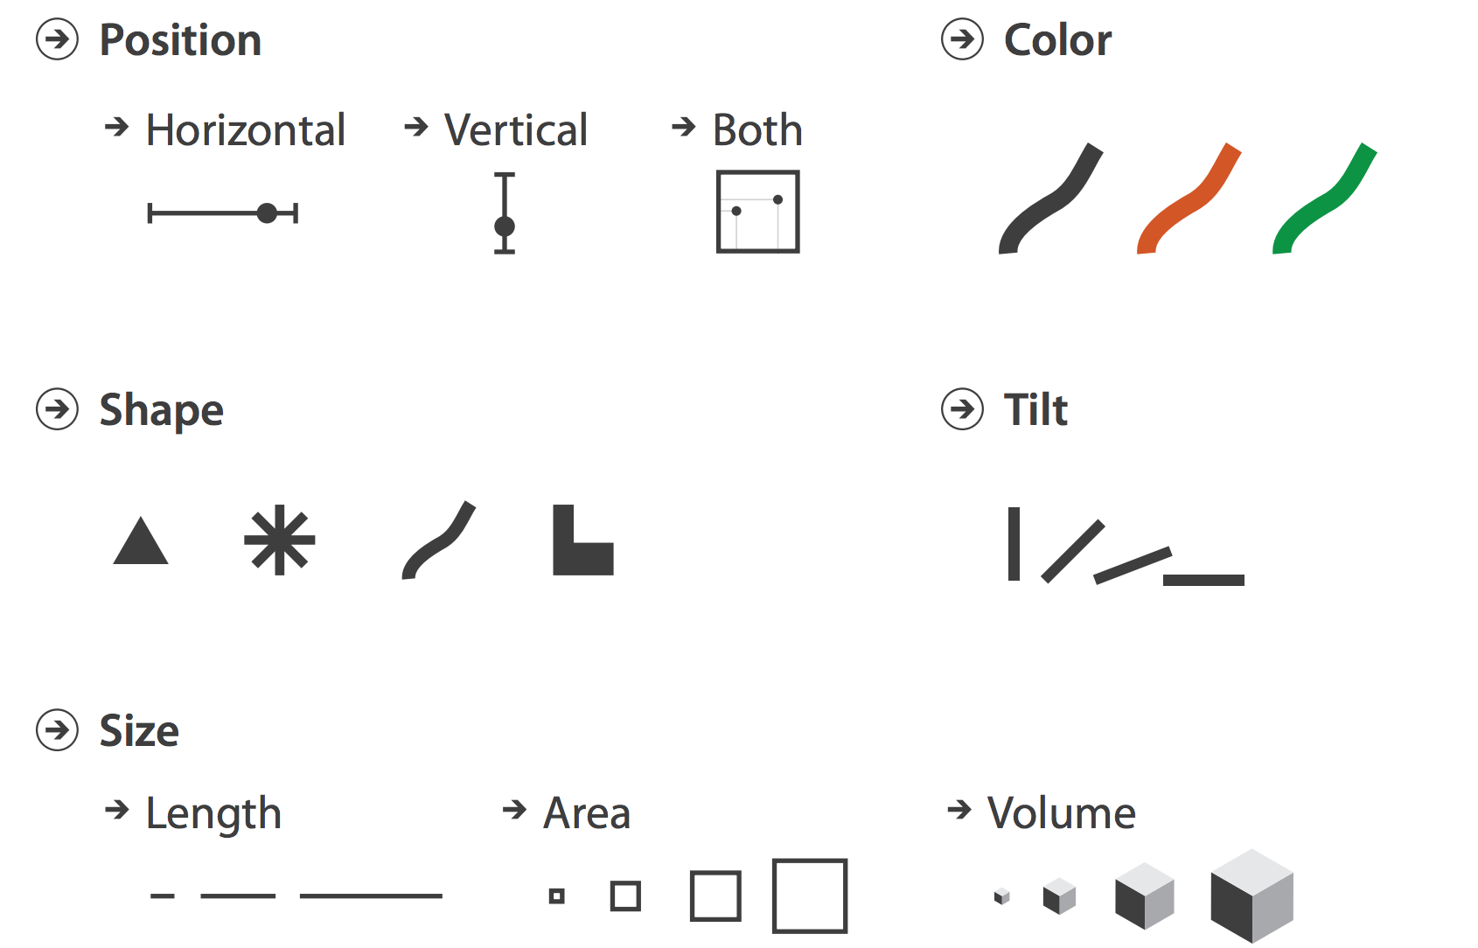
Marks and Channels
Marks: Graphical elements
Points, lines, areas, 3D volumes
Channels: Control visual appearance of marks
Notes:
Marks can operate for items, or for links / connections.
Identity (what) → shapes, hue vs. magnitude (how big) channels -> size, area, volume

Slide 13
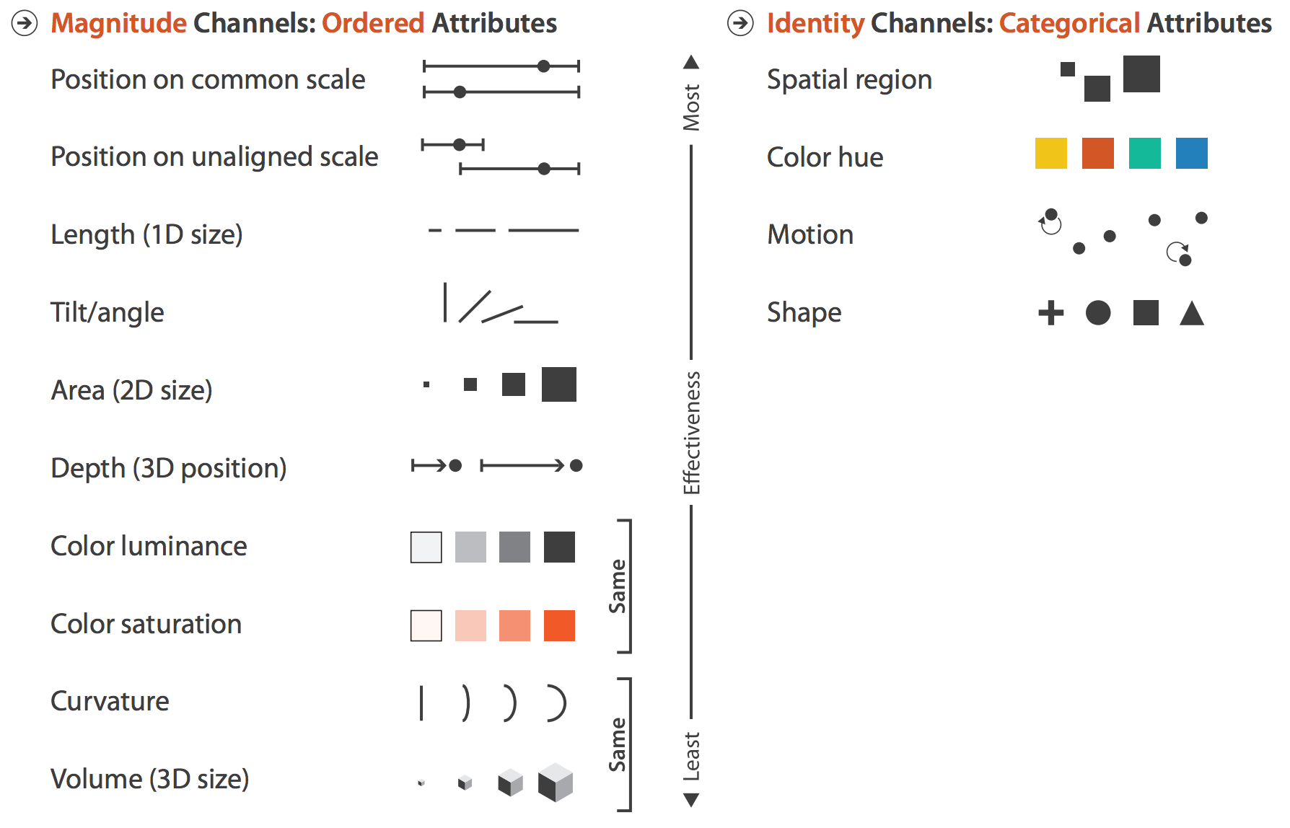
Channel Effectiveness
Notes:
Spatial position is very important.
Perceive some of these with diff levels of accuracy.
Also note that something like color, while it’s very good for marking identity, is very weak when marking magnitude.

Slide 14
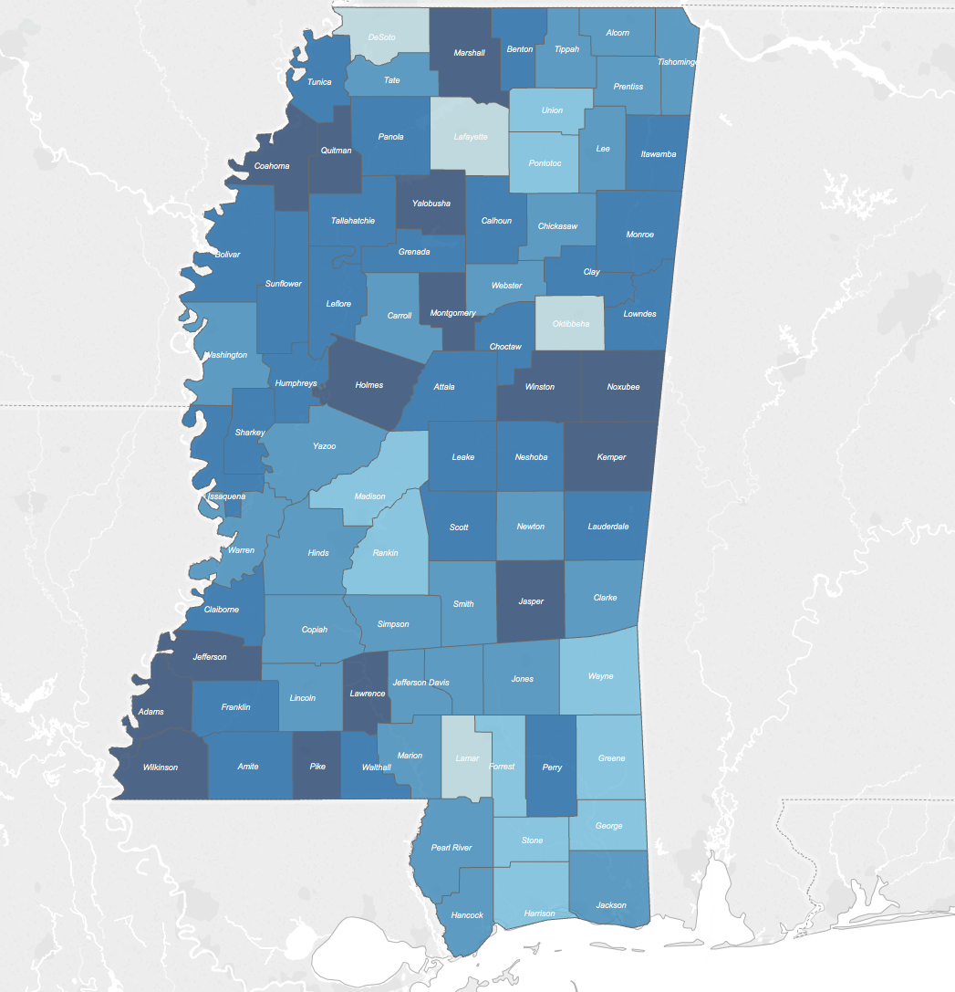
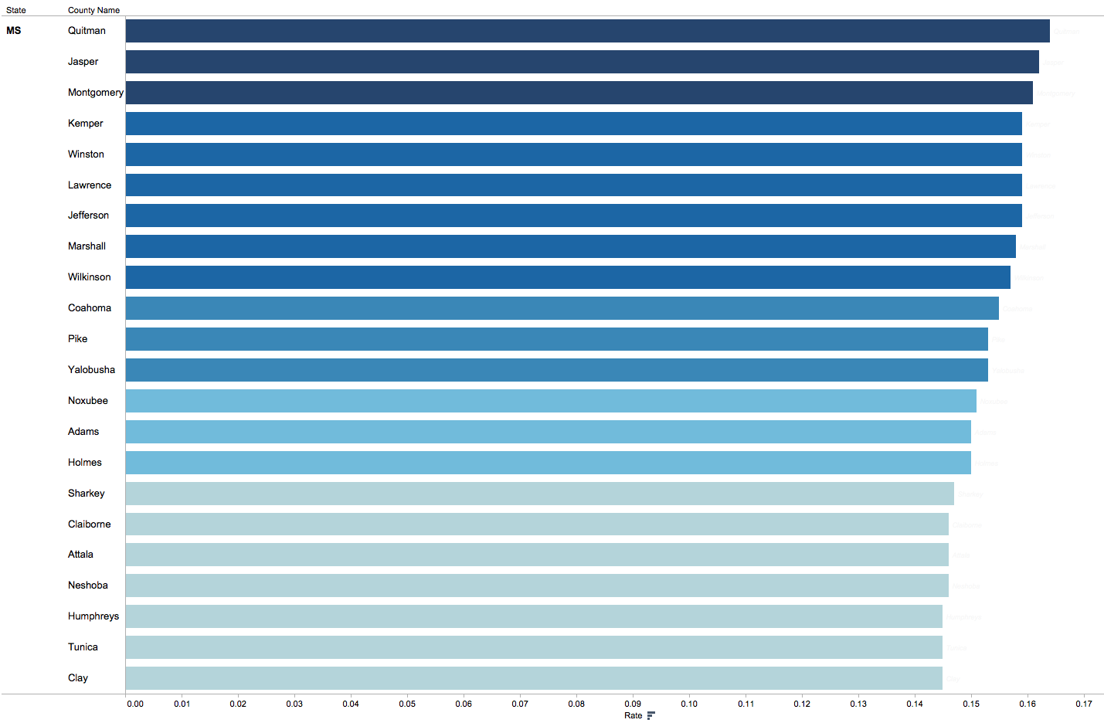
Encoding for Comparison
Notes:
If you want user to find the highest level of diabetes in this map, don’t use a map – use a bar chart. It’s a more effective encoding for comparison

Slide 15
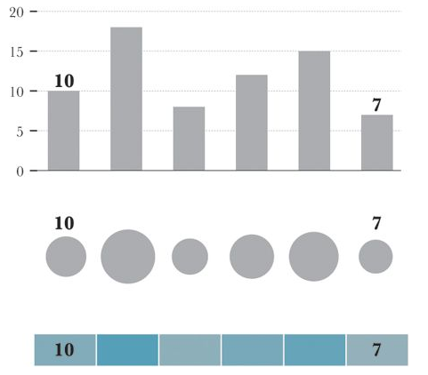
Encoding for Comparison
Notes:
Bar length, vs size, vs color saturation. Which is best?
Need to consider the *discriminability* of a channel … how many different bins are available for a channel. If you have more values than can be effectively encoded you need to reconsider the channel.

Slide 16
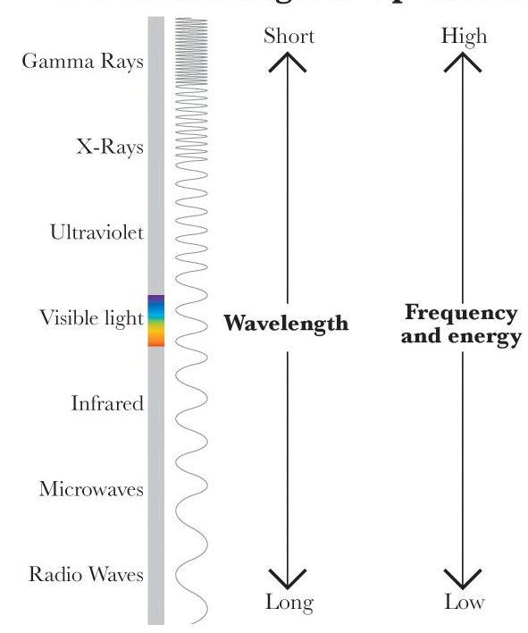
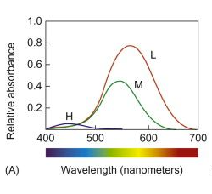
Color Vision
EM Spectrum
Rod vs Cone cells
3 types of cones with diff sensitivities
Notes:
Rod cells are for night vision; cone are for day
Because of the few blue receptors we have blue is not a great color to use for details on a dark background (low luminance contrast, and few blue receptors)
There are 3 channels, including the luminance (B/W) channel

Slide 17
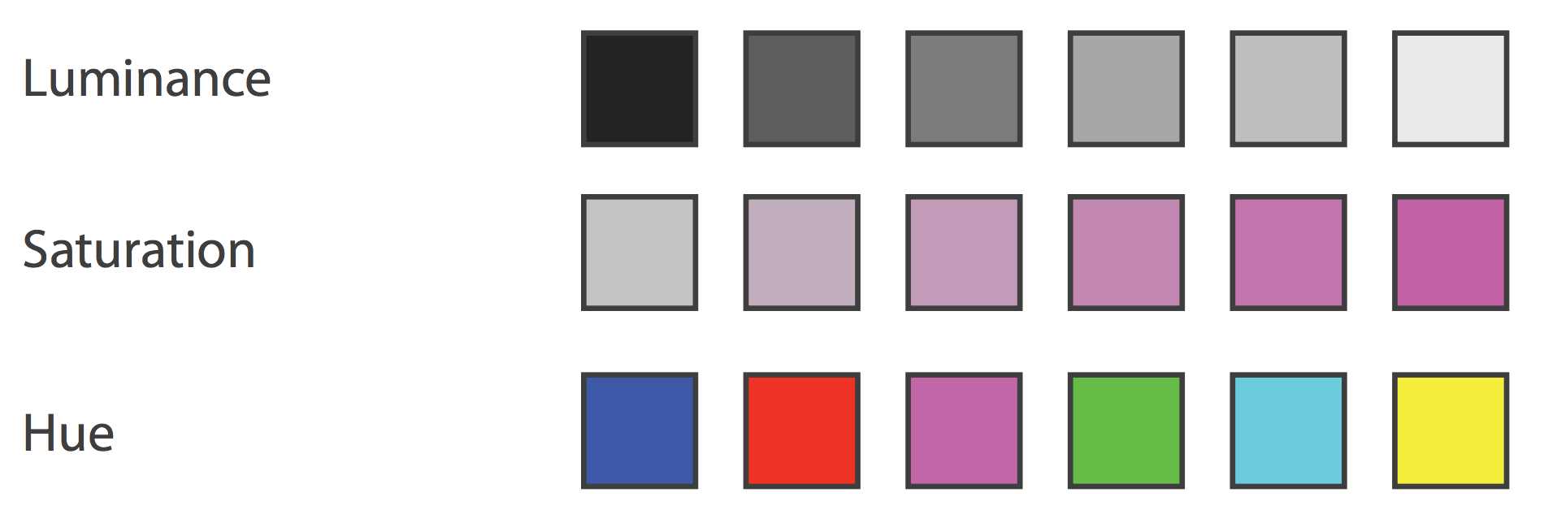
Decomposing Color
Color is not monolithic
Breaks down into luminance, saturation, and hue channels

Slide 18

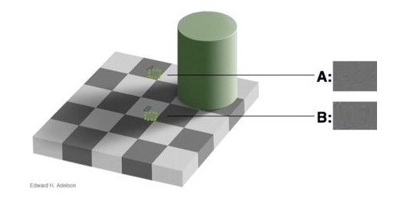
Contrast Sensitivity
Notes:
A and B are the same color, but they look different depending on the surrounding colors. Yet another reason not to introduce visual effects like shadows.
Eye is better at determining relative rather than absolute amounts of light.
If you want different objects of the same color in a table or graph to look the same, make sure that the background—the color that surrounds them—is consistent.

Slide 19
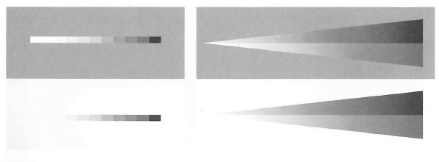
Luminance non-linearity
Notes:
More sensitive to dark gray differences than light differences, but the background matters. With a light background our sensitivity is increased to differences near white.

Slide 20
Color Vision: Color Context
Notes:
Color looks different depending on what colors it’s next to.
We evaluate colors differently if they look like they’re in shadow, based on texture, surrounding colors etc.

Slide 21

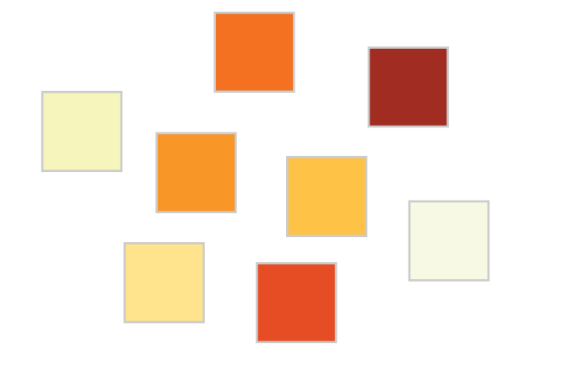
Color Ordering
Try putting the following colors in order from “low” to “high”
Ordered Magnitude
Works with Luminance and Saturation, not Hue
http://www.perceptualedge.com/articles/visual_business_intelligence/rules_for_using_color.pdf

Slide 22
Unique Hues
Most commonly used color words regardless of language
Good for showing Categories
Notes:
These are the colors that have a strong signal on one of the color channels and a neutral signal on other two channels

Slide 23
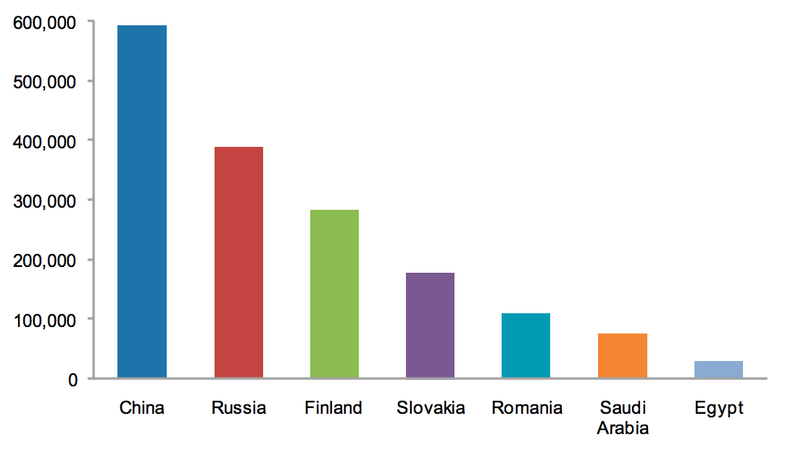
Design Advice
http://www.perceptualedge.com/articles/visual_business_intelligence/rules_for_using_color.pdf
Notes:
Just because we have unique colors does it that mean we should make a bar chart that looks like this? NO! Differences in colors should correspond to differences in meaning.

Slide 24
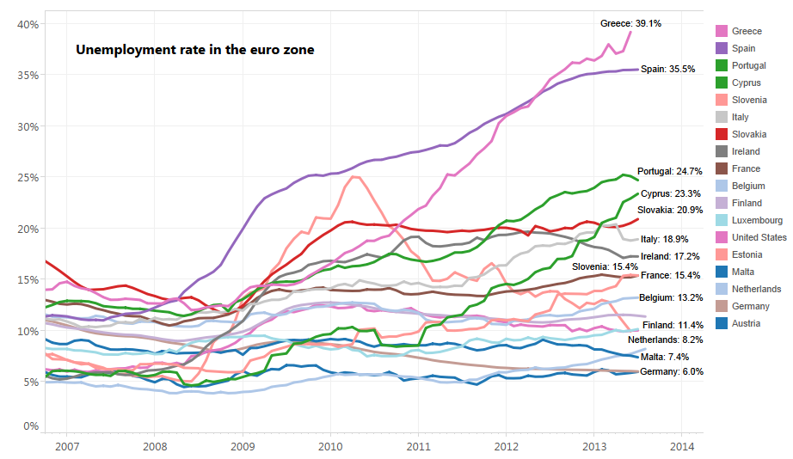
Design Advice
Notes:
Gets the the discriminability idea … there are too many colors here to really discriminate effectively – they get aound this by labeling each line which is a little better, but this could be even better if spatially related groups had similar colors …or you mapped to a single hue the end value so you could see a ranking.

Slide 25
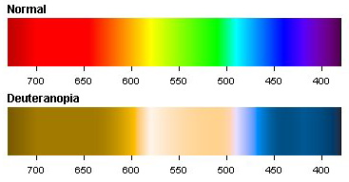
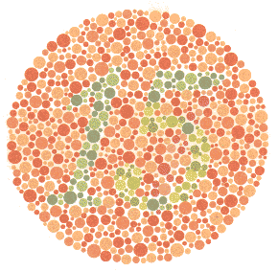
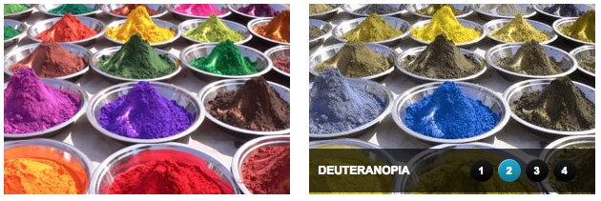
Color Blindness
~8.0 % of men and 0.5% of women are color blind
Red-Green most common
There are different sub-types, commonly only 2 color channels
Notes:
Deuteranopia – R-G colorblindness; Dichromats lack cones sensitive to green light (green-blind); Trichromats (green-weak) have cones that have a color sentitivety closer to red.

Slide 26
Design Implications
Use distinctive colors, but only use colors that correspond to differences in meaning
Avoid color pairs that color blind people will be unable to differentiate
Make color redundant with other cues

Slide 27
More Design Implications
To show detail info (inc. small text), make sure to have luminance contrast
Color differences harder to see
Use unique named colors first, followed by other familiar colors
6-12 is range, then they become undifferentiable with context
Keep background colors low in saturation
Distorts perceived color of small symbols less
When highlighting, maintain luminance contrast
Notes:
1. Don’t put blue text on a dark background b/c there are also few blue cones. But this also goes for yellow on white – the lack of luminance contrast makes it hard to read the text.
Mention discriminability on the 2nd point

Slide 28
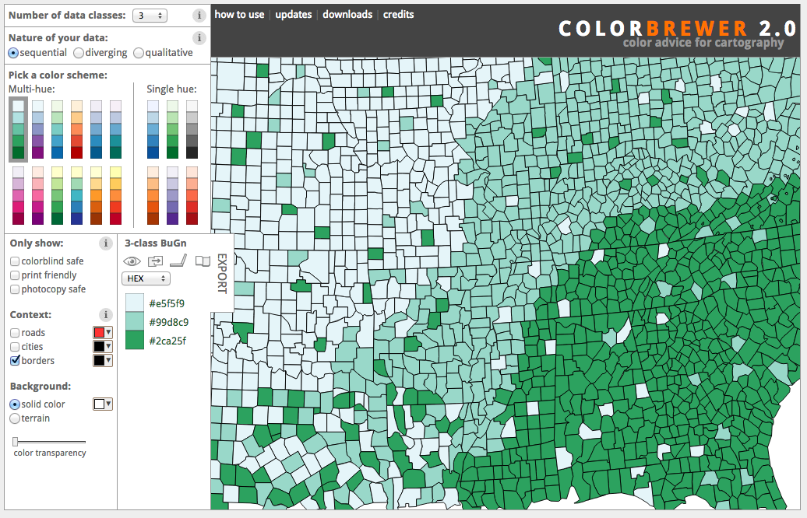
Choosing Color Schemes
http://colorbrewer2.org/
Notes:
Now practically speaking ..
Give a little demo, showing some different options including color blind safe etc.
Can show another example: https://color.adobe.com

Slide 29
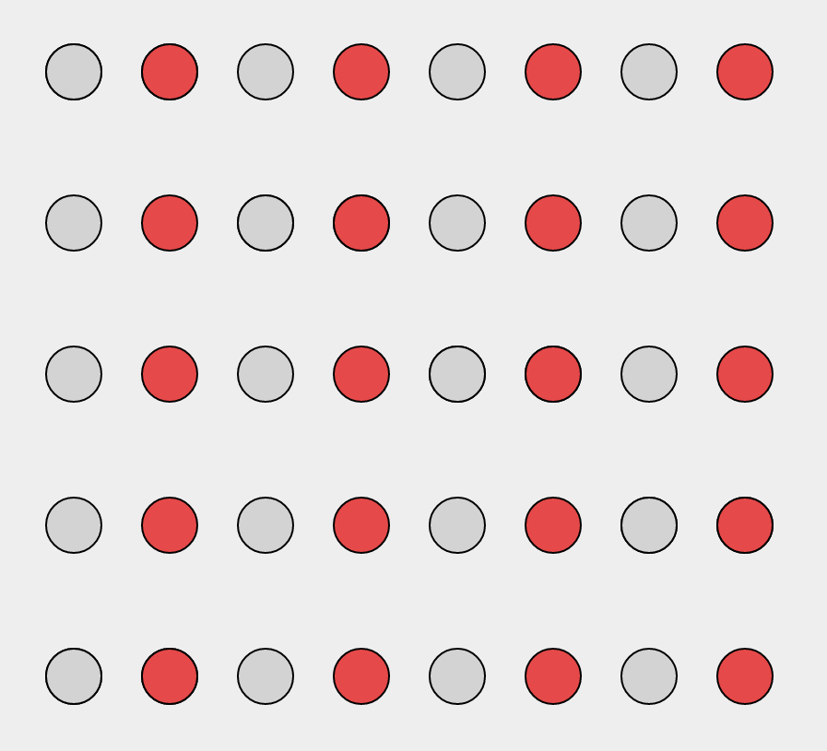
Gestalt Theory - Similarity
https://emeeks.github.io/gestaltdataviz/section1.html
Notes:
We can also discuss design principles that help us organize space for easy perception. This is helpful for thinking through chart design and the use of space like layouts.
Similarity: Objects are perceptually grouped if they are similar to each other.

Slide 30
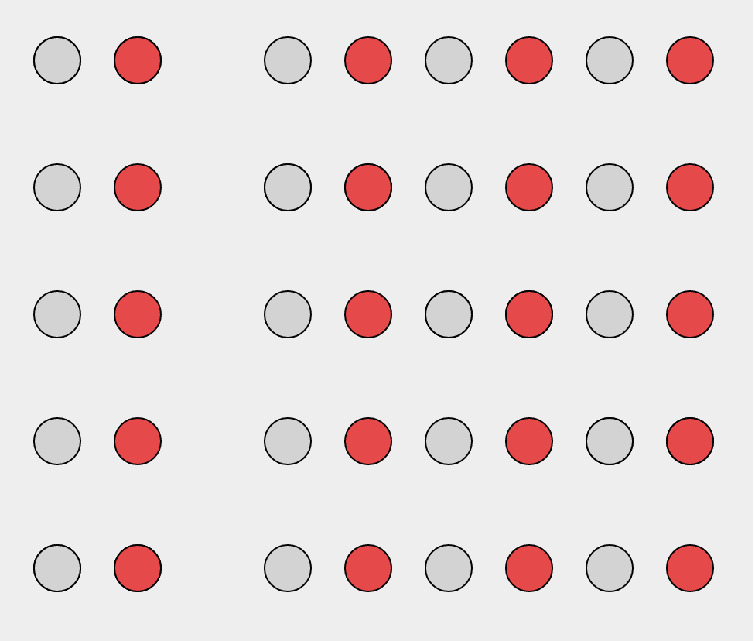
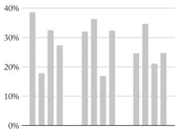
Gestalt Theory – Proximity
Notes:
Proximity: objects close to each other form a group.

Slide 31
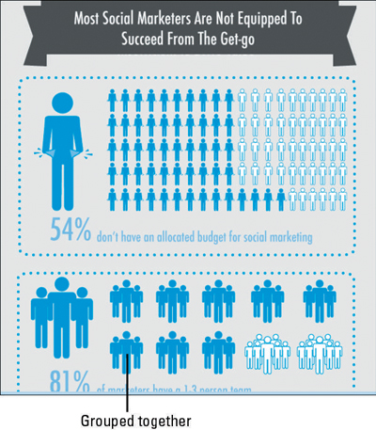
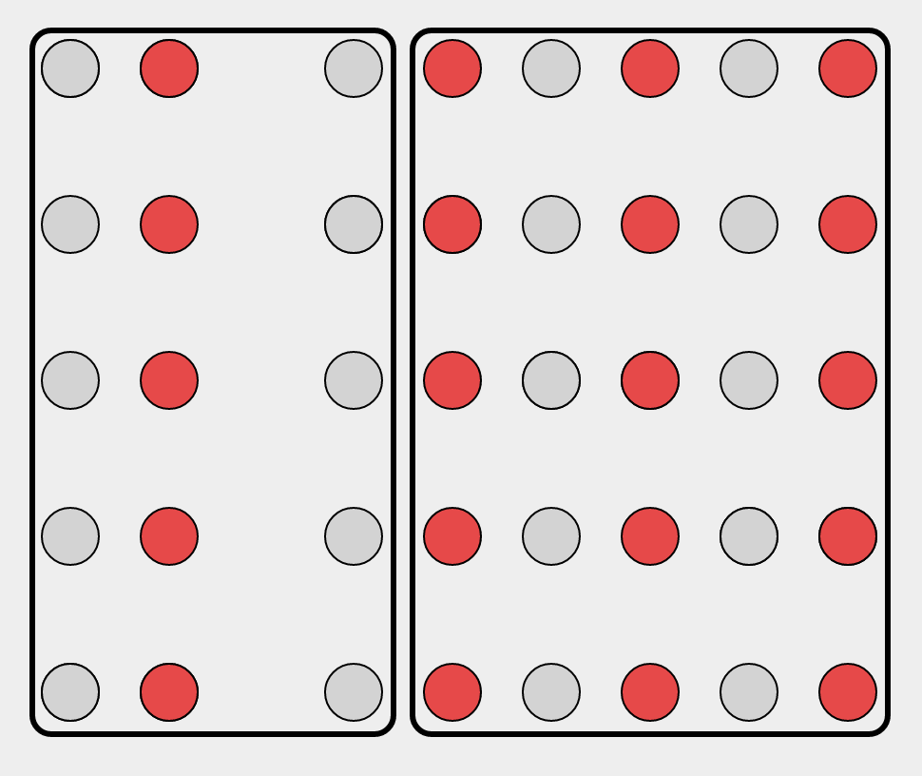
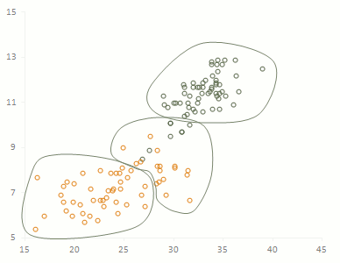
Gestalt Theory – Enclosure
Notes:
enclosure--surrounding a group of related elements with a visual element; in this example is over powers similarity AND proximity.

Slide 32
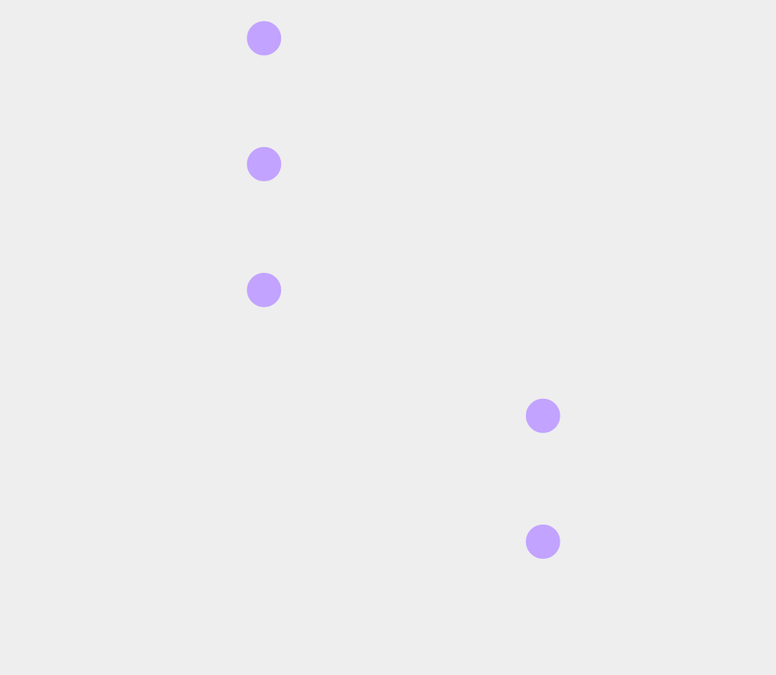
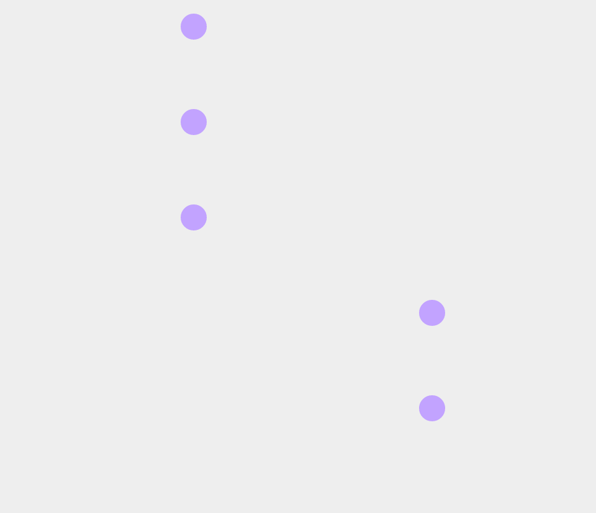
Gestalt Theory – Common Fate
https://emeeks.github.io/gestaltdataviz/section2.html
Notes:
We group together objects that have the same trend of motion

Slide 33
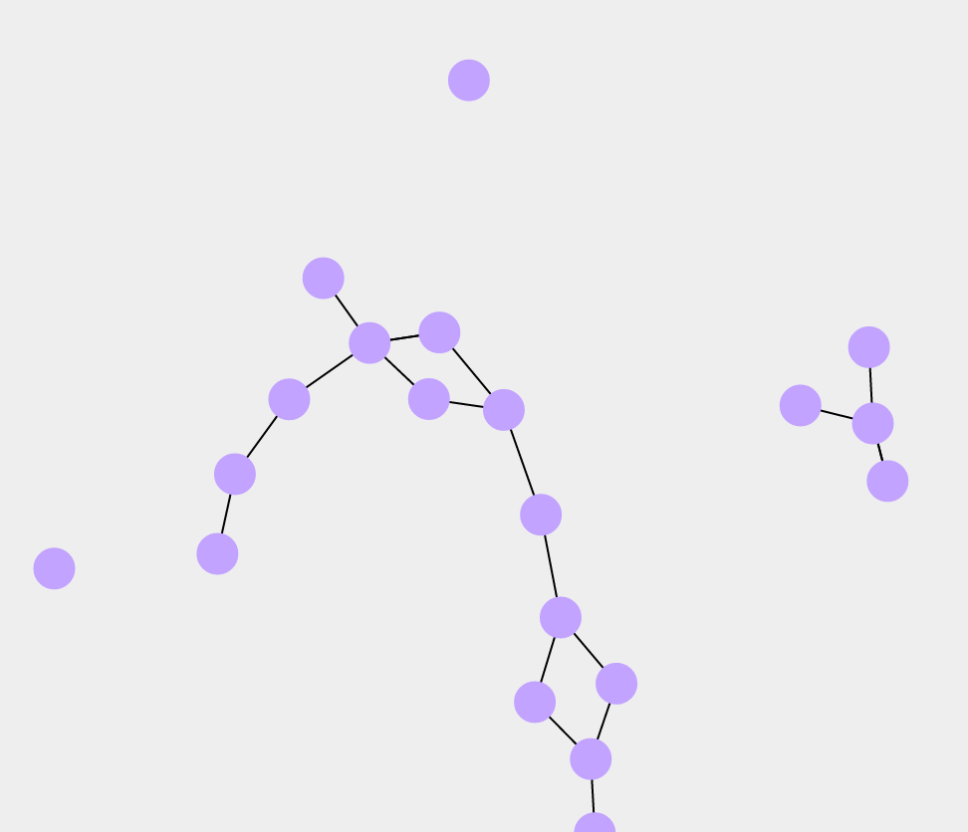
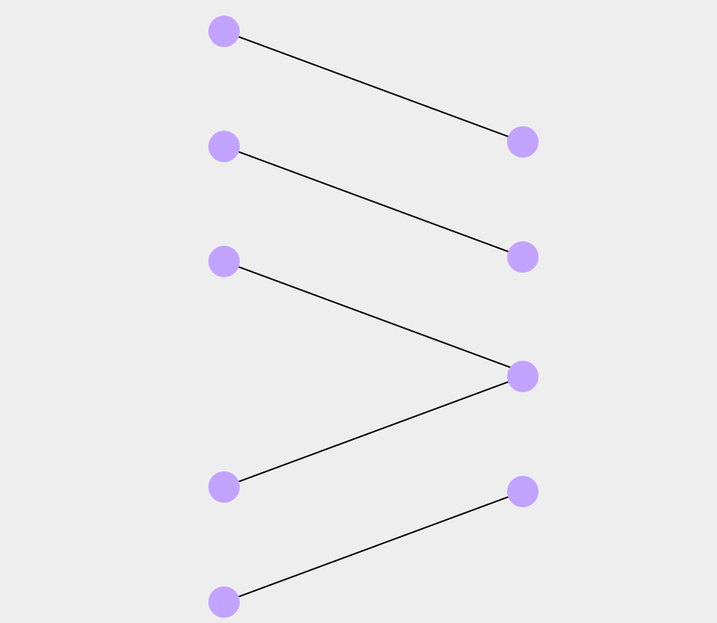
Gestalt Theory - Connectedness
Notes:
Connectedness is a powerful grouping principle that is stronger than proximity, color, size or shape.
You can see it in use in network visualizations.

Slide 34
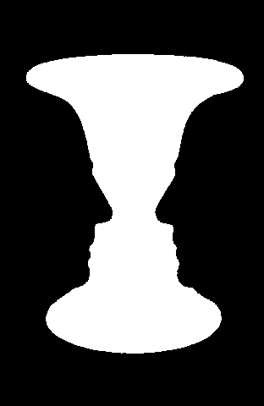
Gestalt Theory – Figure Ground
Notes:
Metastability

Slide 35

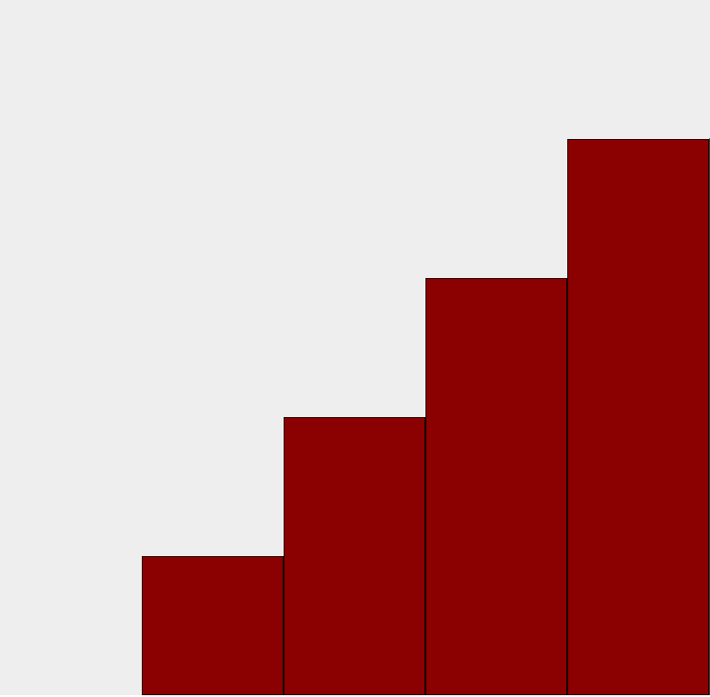
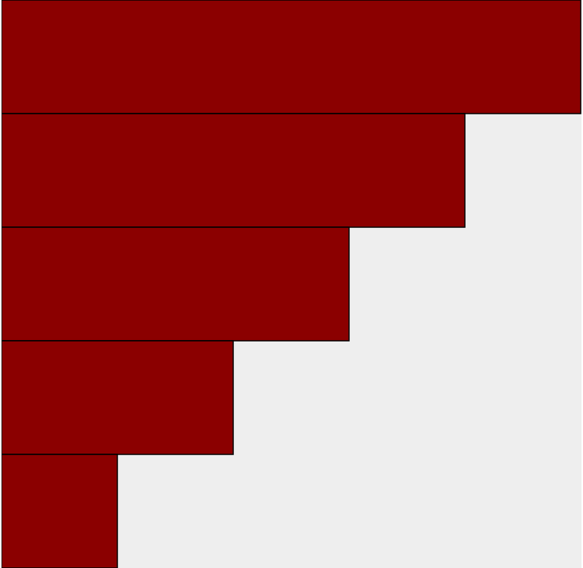
Gestalt Theory – Figure Ground
https://emeeks.github.io/gestaltdataviz/section4.html
Notes:
Metastability – the orange and pink you can read as a horizontal or vertical bar chart.
In the reg / gray we use color to signal the for and background.
Figure ground is the tendency to separate figures from their background.

Slide 36
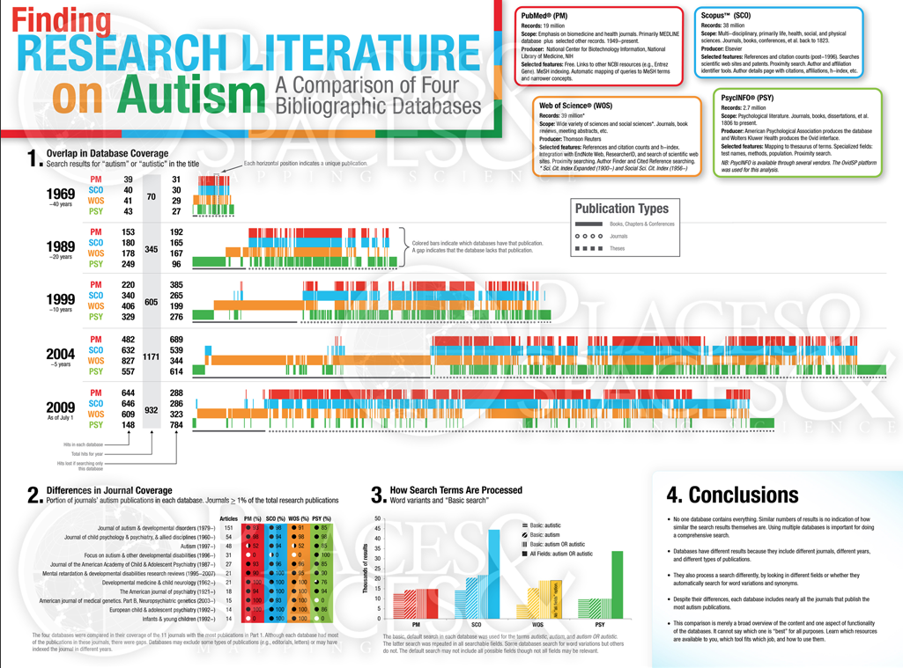
Critique / Analysis
How is data mapped? (i.e. what marks and channels being used?)
How is color used? Is it effective?
How are gestalt laws used?
http://scimaps.org/maps/map/finding_research_lit_126/detail
Notes:
Let’s practice analyzing a visualization to extract all of the data mappings that have been used. Get with a partner and load this guy up.
Take 15-20 minutes to analyze and critique it, then we’ll discuss.
http://scimaps.org/maps/map/finding_research_lit_126/detail

Slide 37
Questions?

